Slide 1
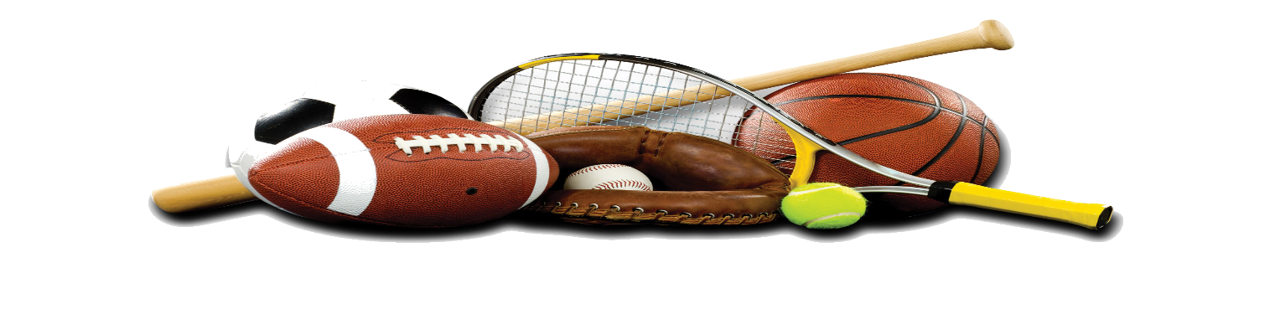

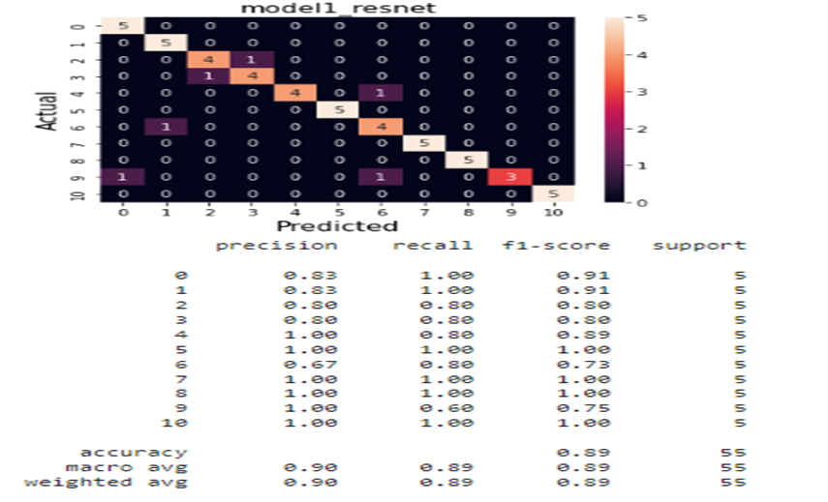
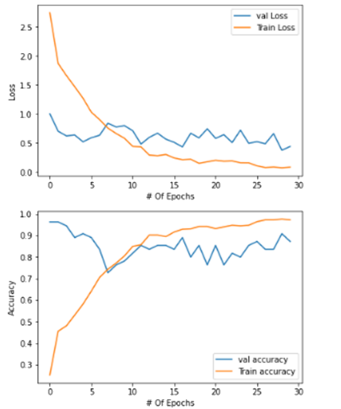
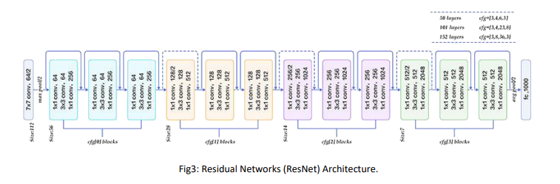
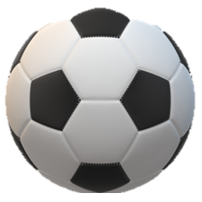
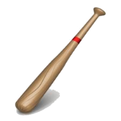
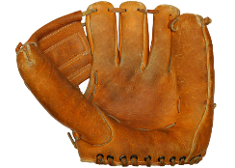
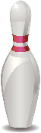
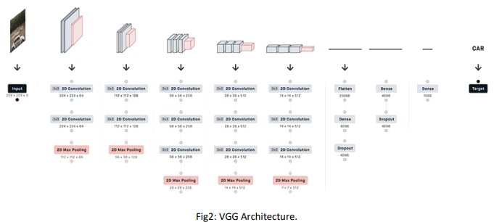
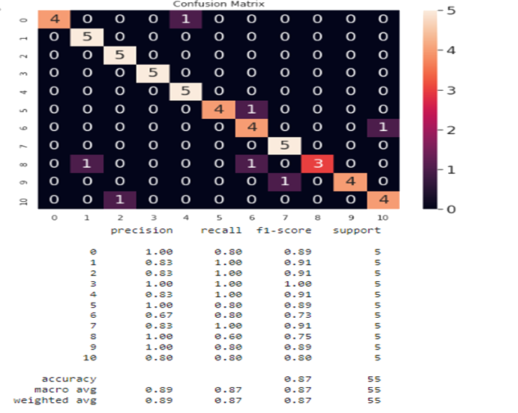
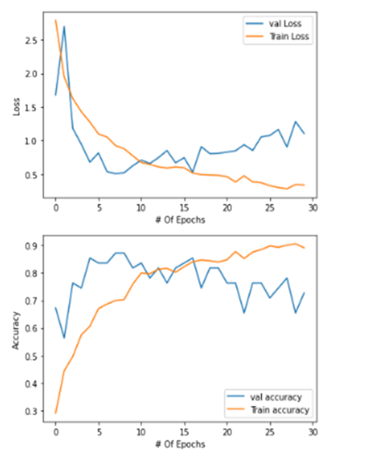
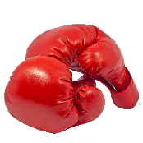
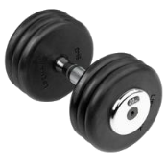
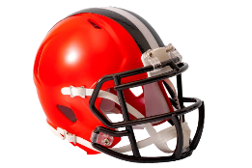
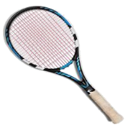
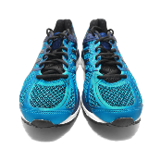
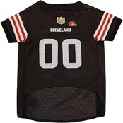
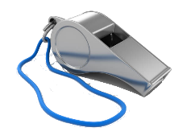
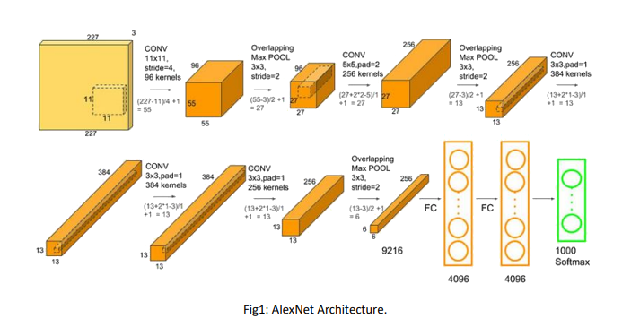
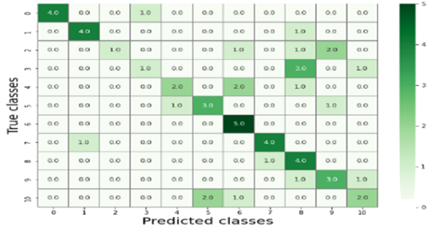
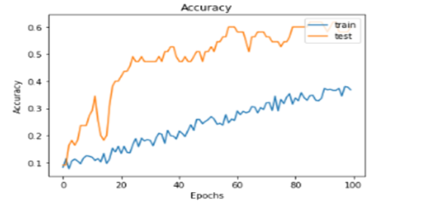
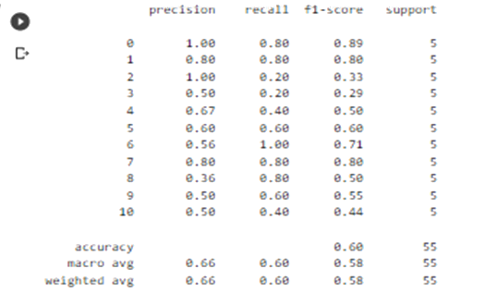
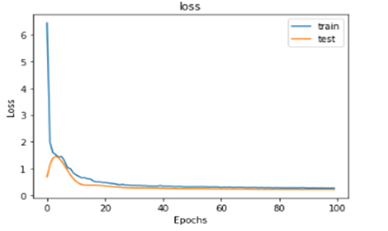
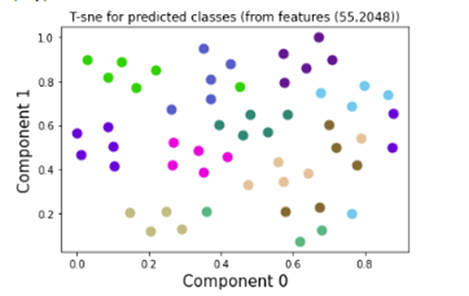
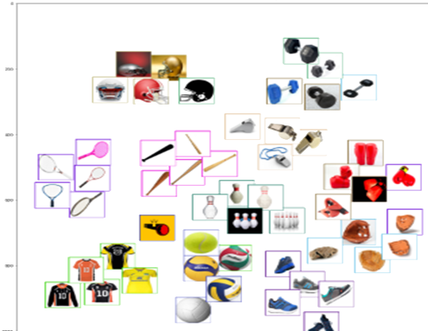
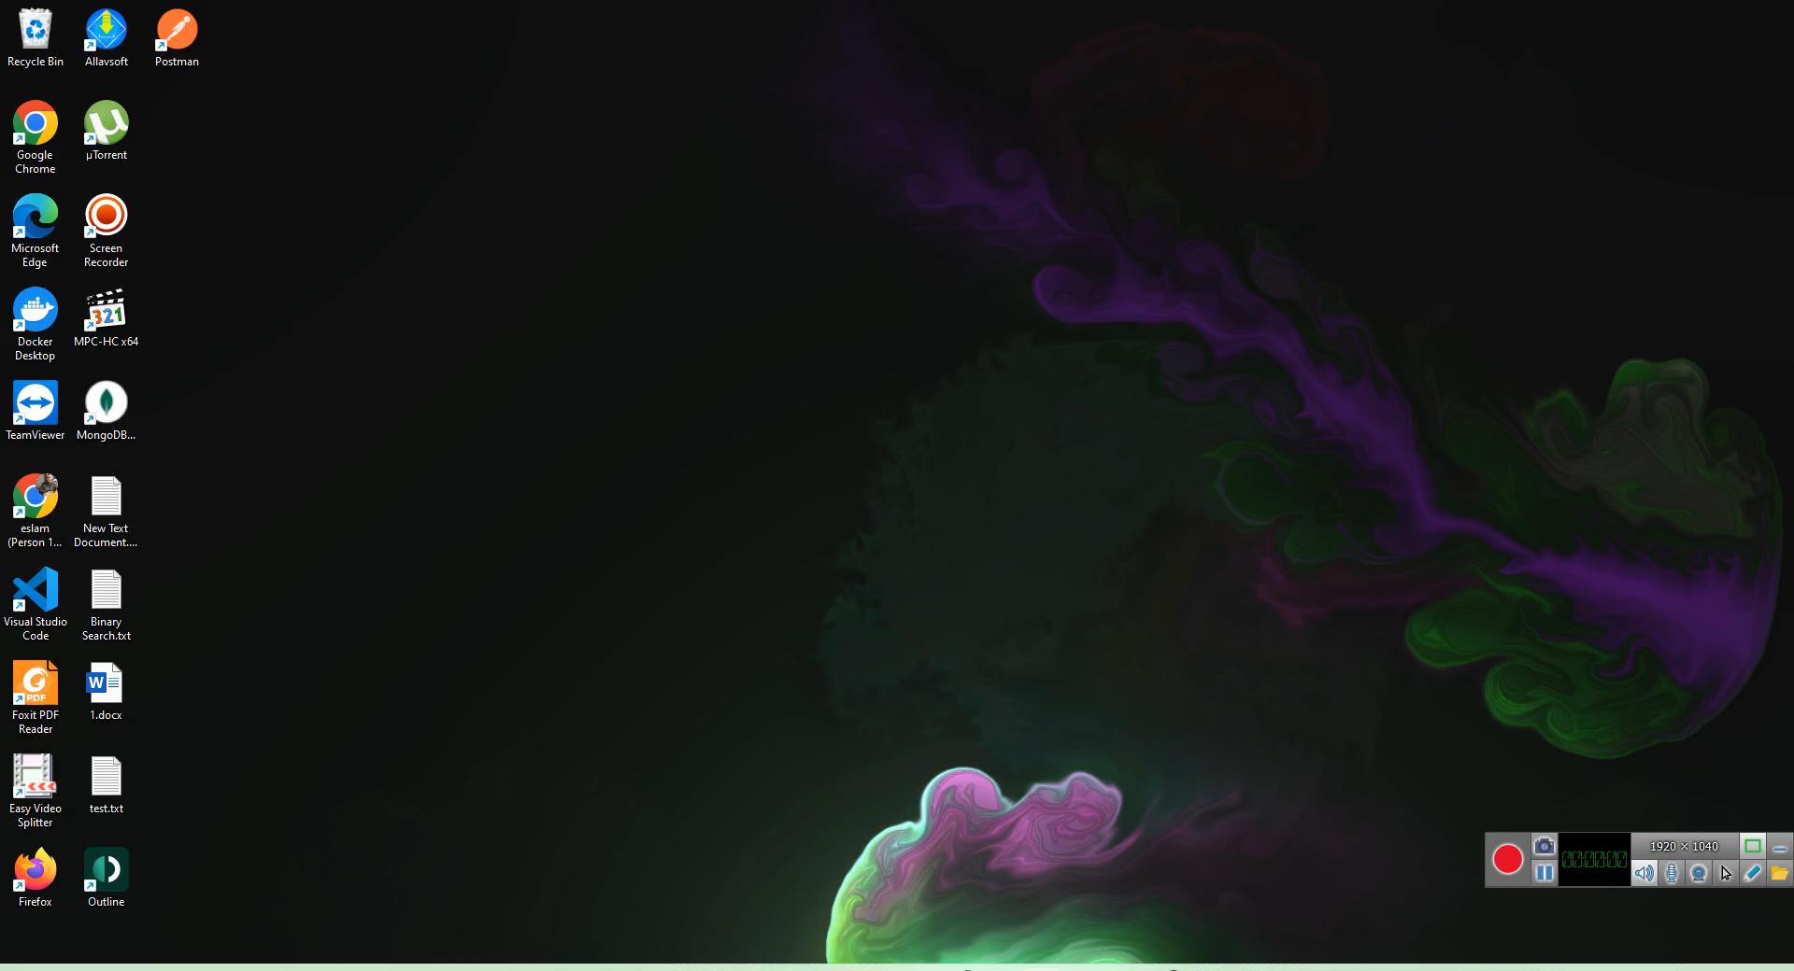
Sports Products Multi-Class Classification
Ahmed Abdo Amin, azad011@uOttawa.ca | Hosam mahmoud ibrahim, hmahm074@uottawa.ca
Abdulrahman Ahmed, aahme275@outtawa.ca | Eslam Abdelraheem Shabaan Khalaf, ekhal066@uottawa.ca
Evaluation
Introduction
Datasets
Methods
First Model (ResNet):
A computer is a critical life need like food and water and we cannot imagine our life without the computer because our all knowledge, activities, works, memories, history, and lifestyles are managed and stored by the computer, in the work area it facilitates and manage many tasks very fast and in an organized way.
How to collect the data set:
First, use an online website to collect images of sports tools.
Second, segment the downloaded images into 11 classes.
First Model (ResNet):
Second Model (VGGModel):
Second Model (VGGModel):
Ball
Baseball bat
Baseball Gloves
Bowling bin
Problem Statement
In previous people used papers to classify products then they used some basic computers software to manage it but in case of using images as products description we need something different to use computer to solve this problem, our thoughts turns quickly to computer vision or machine learning techniques to help us to work with image classification. So, in our project we will work on deep learning project to help us in Sports products multi-class classification problem.
Boxing Gloves
Dumb bell
Football Helmets
Racket
Third Model (AlexNet):
Third Model (AlexNet):
Sport Shoes
T-shirt
Whistle
Finally, 11 classes were split into training, validation, and testing data sets of 440, 55, and 55 images, respectively.
Conclusion
Development
The champion model ResNet 152 with fine tuning
Solution Design:-
This video depicts the website that displays the champion model's results
- Using HTML , CSS and JavaScript for the design.
- Using a flask library to connect our model with the user interface.

